Slide 1


AsSalam Alaykum!

Slide 2
The Muslim Identity
Islam and the building of Character
Muhammad Bashar Shala

Slide 3
“IDENTITY”
Webster Dictionary: “the distinguishing character or personality of an individual”
Character:
  Behavior
  Appearance
  Distinguishing Characteristics of Personality

Slide 4
“IDENTITY”
Self-defining attributes
  Race/Ethnicity (White, Black, Asian, etc)
  National Origin (Indo-Paki, Arab, etc)
  Gender (Feminism)
  Religion
We define our Identity based on what we believe is our most important and distinguishing character!

Slide 5
Muslim Identity
Can religion form a certain character or personality?
Is there a distinguished Islamic Character?
How can religion form a certain character?

Slide 6
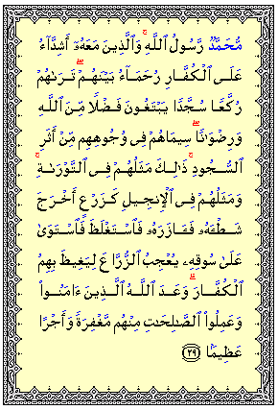
Muslim Identity
Muhammad صلى الله عليه وسلم is the Messenger of Allah. And those who are with him are severe against disbelievers, and merciful among themselves. You see them bowing and falling down prostrate (in prayer), seeking Bounty from Allah and (His) Good Pleasure. The mark of them (i.e. of their Faith) is on their faces from the traces of prostration (during prayers). …..
الفتح

Slide 7
Religion and Character
Religion
Creed
Practice
Submitting
Embracing
Person
Religious Identity
Character Transformation

Slide 8
Religion and Character
Islam
Creed
العقيدة
Practice
الأركان
Muslim
Behavior
Appearance
Islamic Identity
Character Transformation

Slide 9

Building Character through Creed
Aqeedah (Creed)
  Tawheed Uloohiyah
    Allah is One in His rights to be worshiped alone
  Tawheed Ruboobiyah and Asmaa’
    Allah is One and Unique in His Lordship
    Allah is One and Unique in His Names and Attributes

Slide 10
Building Character through Creed
Tawheed Uloohiyah
    Allah is One in His rights to be worshiped alone
Servitude
Dedication
Submission
Dignity
Humbleness

Slide 11
Building Character through Creed
  Tawheed Ruboobiyah and Asmaa’
    Allah is One and Unique in His Lordship, His Names and Attributes.
Independence
Strength
Dignity

Slide 12
Building Character through Worship
  Salah
  Zakah
  Sawm
  Hajj

Slide 13
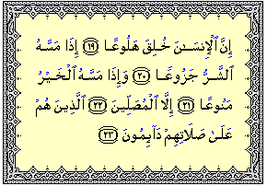
Building Character through Worship
  Salah
Strength
Dignity
Verily, man was created very impatient;
Irritable (discontented, panicking) when evil touches him;
And niggardly when good touches him.
Except those who are devoted to Salah (prayers).
Those who remain constant in their Salah (prayers);
المعارج

Slide 14
Building Character through Worship
  Salah
Cleanliness
Wudu: Ablution
Ghusl: Shower, Bath
Perfume (for Men)
Siwak: Dental hygien
أخرج ابن ماجة عن ابن عباس رضي الله عنهما قال : قال رسول الله : (( إن هذا يوم عيد جعله الله للمسلمين فمن جاء إلى الجمعة فليغتسل، وإن كان عنده طيب فليمس منه، وعليكم بالسواك ))

Slide 15
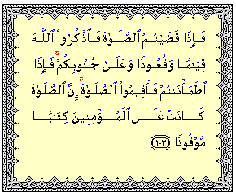
Building Character through Worship
  Salah
Punctuality
When you have finished As-Salah (the congregational prayer), remember Allah standing, sitting down, and (lying down) on your sides, but when you are free from danger, perform As-Salah. Verily, As-Salah (the prayer) is enjoined on the believers at fixed hours.
النساء

Slide 16
Building Character through Worship
Being Considerate of Others
  Salah
عن جابر أنَّ رسول الله قال: ((مَن أكَلَ البصلَ والثومَ والكرّات فلا يقربنَّ مسجدنا؛ فإنَّ الملائكة تتأذَّى مما يتأذَّى منه بنو آدم)) أخرجه مسلم
عن أبي سعيد الخدريّ قال: اعتكف رسول الله في المسجدِ، فسمعهم يجهرون بالقراءةِ، فكشف السترَ فقال: ((ألا إنَّ كلَّكم مناجٍ ربَّه، فلا يؤذِيَنَّ بعضكم بعضًا، ولا يرفَع بعضكم على بَعضٍ في الصلاة)) أخرجه أحمد وأبو داود.

Slide 17
Building Character through Worship
  Salah
Leadership
Following Leaders
Humbleness/Humility
Commitment
Dedication

Slide 18
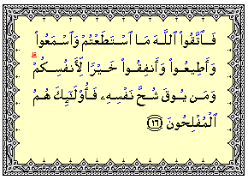
Building Character through Worship
  Zakah
Generosity
So keep your duty to Allah and fear Him as much as you can; listen and obey, and spend in charity; that is better for yourselves. And whosoever is saved from his own covetousness, then they are the successful ones.
التغابن

Slide 19
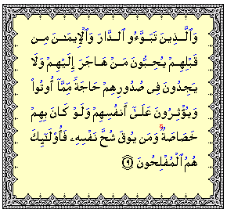
Building Character through Worship
  Zakah
Selflessness
And (it is also for) those who, before them, had homes (in Al-Madinah) and had adopted the Faith, love those who emigrate to them, and have no jealousy in their breasts for that which they have been given, and give them preference over themselves even though they were in need of that.
And whosoever is saved from his own covetousness, such are they who will be the successful.
الحشر

Slide 20
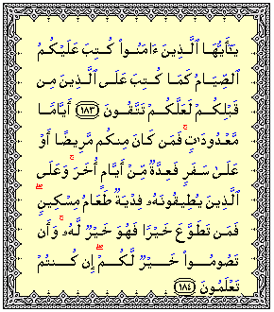
Building Character through Worship
  Sawm
Patience
Endurance
O you who believe! Observing As-Sawm (the fasting) is prescribed for you as it was prescribed for those before you, that you may become the pious .
for a fixed number of days, but if any of you is ill or on a journey, the same number (should be made up) from other days. And as for those who can fast with difficulty, they have (a choice either to fast or) to feed a poor person. But whoever does good of his own accord, it is better for him. And that you fast is better for you if only you know.
البقرة

Slide 21
Building Character through Worship
  Sawm
Self-Control
O you who believe! Observing As-Sawm (the fasting) is prescribed for you as it was prescribed for those before you, that you may become the pious .
for a fixed number of days, but if any of you is ill or on a journey, the same number (should be made up) from other days. And as for those who can fast with difficulty, they have (a choice either to fast or) to feed a poor person. But whoever does good of his own accord, it is better for him. And that you fast is better for you if only you know.
البقرة

Slide 22
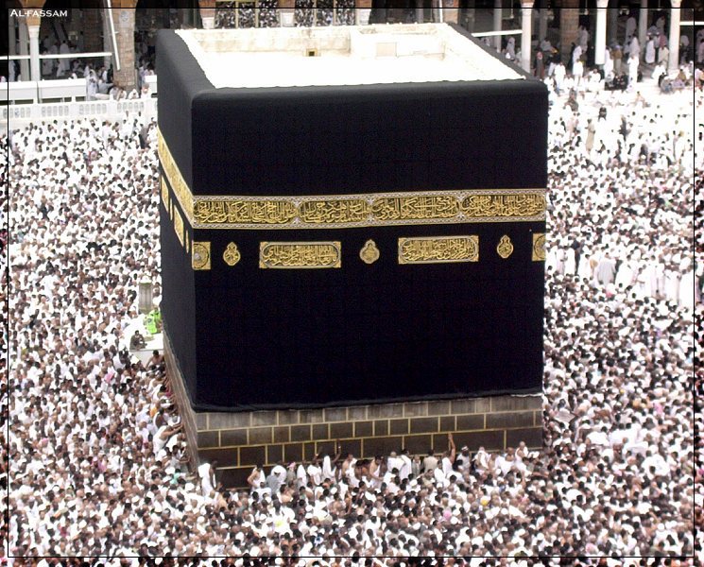
Building Character through Worship
  Hajj
Equality
Humbleness
Belonging to Ummah
Endurance

Slide 23
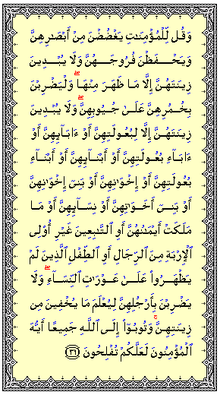
Building Character through Worship
  Dress Code
Modesty
And tell the believing women to lower their gaze (from looking at forbidden things), and protect their private parts (from illegal sexual acts) and not to show off their adornment except only that which is apparent, and to draw their veils all over their folds) faces, necks and bosoms) and not to reveal their adornment except to their husbands, or their father….
And let them not stamp their feet so as to reveal what they hide of their adornment. And all of you beg Allah to forgive you all, O believers, that you may be successful.
النور

Slide 24
Muslim Identity
Selflessness
Punctuality
Self-Control
Endurance
Leadership
Following Leaders
Generosity
Independence
Strength
Cleanliness
Patience
Dignity
Humbleness
Commitment
Dedication
Being Considerate of Others
Modesty

Slide 25
Muslim Identity
Character
  Absorb Islamic teaching into our personality
Behavior
  Act according to Islamic morals and ethics
Appearance
  The Islamic “look” in modesty and cleanliness

Slide 26
Islam
Creed
العقيدة
Practice
الأركان
Muslim
Behavior
Appearance
Islamic Identity
Character Transformation
Representing Islam
(Da’wah)
Living Islam
(Application)

Slide 27
Muslim Identity
We need to identify ourselves as Muslims, first and foremost.
We need to reflect Islam in our character, behavior and appearance.
Our Islamic Identity is the living example for Da’wah to Islam

Slide 28
Muslim Identity
Islam…
Love it!
Live it!

Slide 29
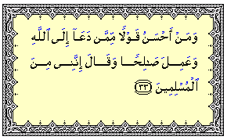
  Deploying the Muslim Identity and Character in Da’wah
And who is better in speech than he who invites to Allah, and does righteous deeds, and says: "I am one of the Muslims."
فصلت

Slide 30
Manners of Da’wah
First: Arm yourself!
  Piety (Taqwa)
  Knowledge (Ilm)
  Sincerity (Ikhlas)
Commitment
Dedication

Slide 31
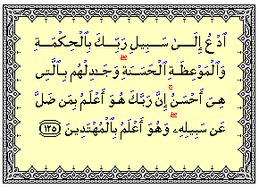
Manners of Da’wah
Use wisdom and gentle advice
Invite to the Way of your Lord with wisdom and fair preaching, and argue with them in a way that is better. Truly, your Lord knows best who has gone astray from His Path, and He is the Best Aware of those who are guided.
النحل
Humbleness
Being Considerate of Others

Slide 32
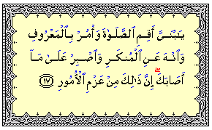
Manners of Da’wah
Patience: Be prepared to endure harm
"O my son! Perform As-Salat, enjoin good, and forbid evil, and bear with patience whatever befalls you.
Verily, these are some of the important commandments.
لقمان
Endurance
Strength

Slide 33
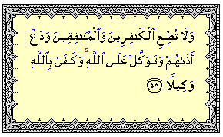
Manners of Da’wah
Rely on Allah and trust in Him
And obey not (the behests) of the Unbelievers and the Hypocrites, and heed not their annoyances, but put your trust in Allah. For enough is Allah as a Disposer of affairs.
الأحزاب
Independence
Strength

Slide 34
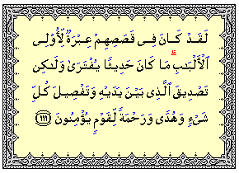
Manners of Da’wah
Inspire guidance from the Stories of the Quran and Seerah
Indeed in their stories, there is a lesson for men of understanding. It is not a forged statement but a confirmation of which were before it and a detailed explanation of everything and a guide and a Mercy for the people who believe.
يوسف
Commitment
Dedication
Strength
Endurance

Slide 35
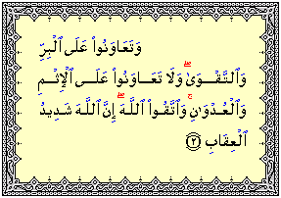
Manners of Da’wah
Work with others in cooperation
Help you one another in Al-Birr and At-Taqwa (virtue, righteousness and piety); but do not help one another in sin and transgression. And fear Allah. Verily, Allah is Severe in punishment.
المائدة
Leadership
Following Leaders

Slide 36
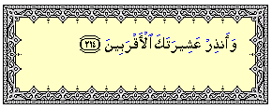
Manners of Da’wah
Be a good example!
Accept advice and criticism!
Selflessness, focus on the goal!
Start with the closest circle to you!
And admonish your nearest kinsmen!
الشعراء

Slide 37
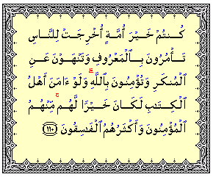
“The Best of People”
“You are the best of peoples ever raised up for mankind; you enjoin Al-Ma‘ruf (Good) and forbid Al-Munkar (Evil), and you believe in Allah…..”
آل عمران

Slide 38
Muslim Identity
Islam…
Learn it!
Love it!
Live it!

Slide 39
  Da’wah Challenges
What stops people from engaging in Da’wah?
  Fear of Mockery
  Fear of being harmed
  Fear of losing friends/Social isolation
  Depending on “others” to do the job

Slide 40
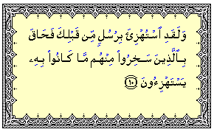
  Da’wah Challenges
Fear of Mockery
And indeed (many) Messengers before you were mocked at, but their scoffers were surrounded by the very thing that they used to mock at.
الأنعام

Slide 41
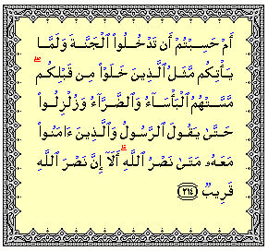
  Da’wah Challenges
Fear of being harmed
Or think you that you will enter Paradise without such (trials) as came to those who passed away before you? They were afflicted with severe poverty and ailments and were so shaken that even the Messenger and those who believed along with him said, "When (will come) the Help of Allah?" Yes! Certainly, the Help of Allah is near!
البقرة

Slide 42
  Da’wah Challenges
Fear of losing friends/Social isolation
  Father of Ibrahim
  Son of Nooh
  Quraysh’s Siege against Muslims (embargo)

Slide 43
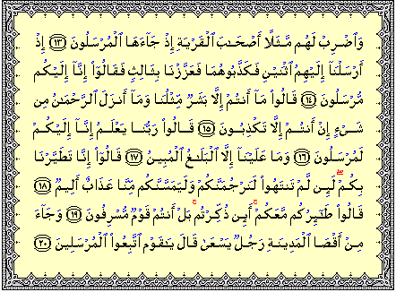
  Da’wah Challenges
Depending on “others” to do the job
And put forward to them a similitude: the (story of the) dwellers of the town, when there came Messengers to them.
When We sent to them two Messengers, they belied them both; so We reinforced them with a third, and they said: "Verily we have been sent to you as Messengers."
They (people of the town) said: "You are only human beings like ourselves, and the Most Gracious (Allah) has revealed nothing. You are only telling lies.“ ………..
…………And there came a man running from the farthest part of the town. He said: "O my people! Obey the Messengers.
يس

Slide 44
“The Best of People”
“You are the best of peoples ever raised up for mankind; you enjoin Al-Ma‘ruf (Good) and forbid Al-Munkar (Evil), and you believe in Allah…..”
آل عمران

Slide 45
Muslim Identity
Islam…
Learn it!
Love it!
Live it!
Spread it!

